Slide 1
Program design and analysis
Software modem.

Slide 2
Theory of operation
Frequency-shift keying:
  separate frequencies for 0 and 1.
0
1
time

Slide 3
FSK encoding
Generate waveforms based on current bit:
bit-controlled
waveform
generator
0110101

Slide 4
FSK decoding
zero filter
detector
0 bit
A/D converter
one filter
detector
1 bit

Slide 5
Transmission scheme
Send data in 8-bit bytes. Arbitrary spacing between bytes.
Byte starts with 0 start bit.
Receiver measures length of start bit to synchronize itself to remaining 8 bits.
start (0)
bit 1
bit 2
bit 3
bit 8
...

Slide 6
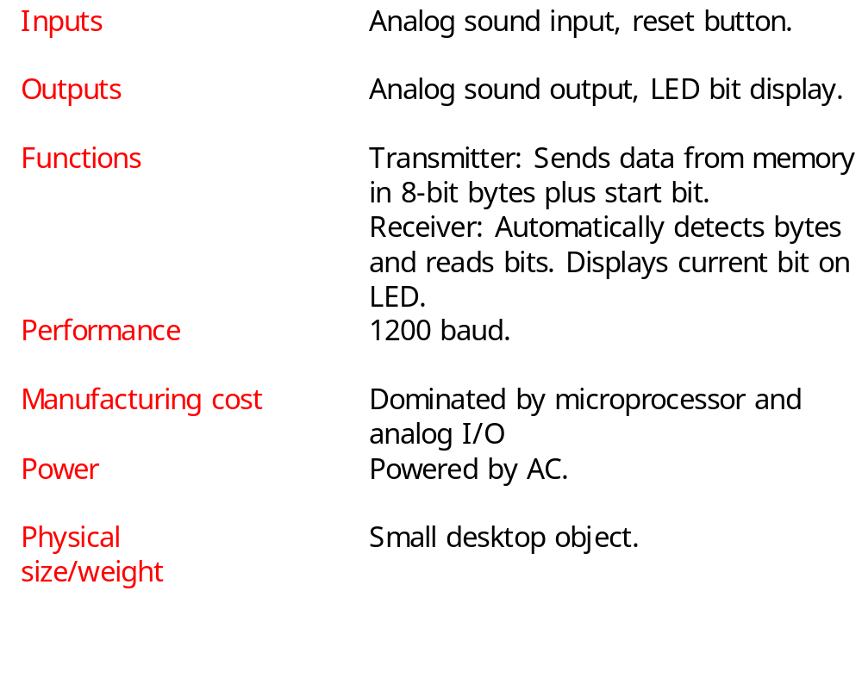
Requirements

Slide 7
Specification
Line-in*
Receiver
1
1
input()
sample-in()
bit-out()
Transmitter
Line-out*
1
1
bit-in()
sample-out()
output()

Slide 8
System architecture
Interrupt handlers for samples:
  input and output.
Transmitter.
Receiver.

Slide 9
Transmitter
Waveform generation by table lookup.
  float sine_wave[N_SAMP] = { 0.0, 0.5, 0.866, 1, 0.866, 0.5, 0.0, -0.5, -0.866, -1.0, -0.866, -0.5, 0};
time

Slide 10
Receiver
Filters (FIR for simplicity) use circular buffers to hold data.
Timer measures bit length.
State machine recognizes start bits, data bits.

Slide 11
Hardware platform
CPU.
A/D converter.
D/A converter.
Timer.

Slide 12
Component design and testing
Easy to test transmitter and receiver on host.
Transmitter can be verified with speaker outputs.
Receiver verification tasks:
  start bit recognition;
  data bit recognition.

Slide 13
System integration and testing
Use loopback mode to test components against each other.
  Loopback in software or by connecting D/A and A/D converters.

